Slide 1
2022 Reach Codes Initiative
Advancing safer, healthier and more affordable buildings and vehicles
Slide Deck Library for Municipal Use
BayAreaReachCodes.Org

Slide 2
Non-profit, locally-led electricity providers
EBCE, PCE, SVCE

Slide 3
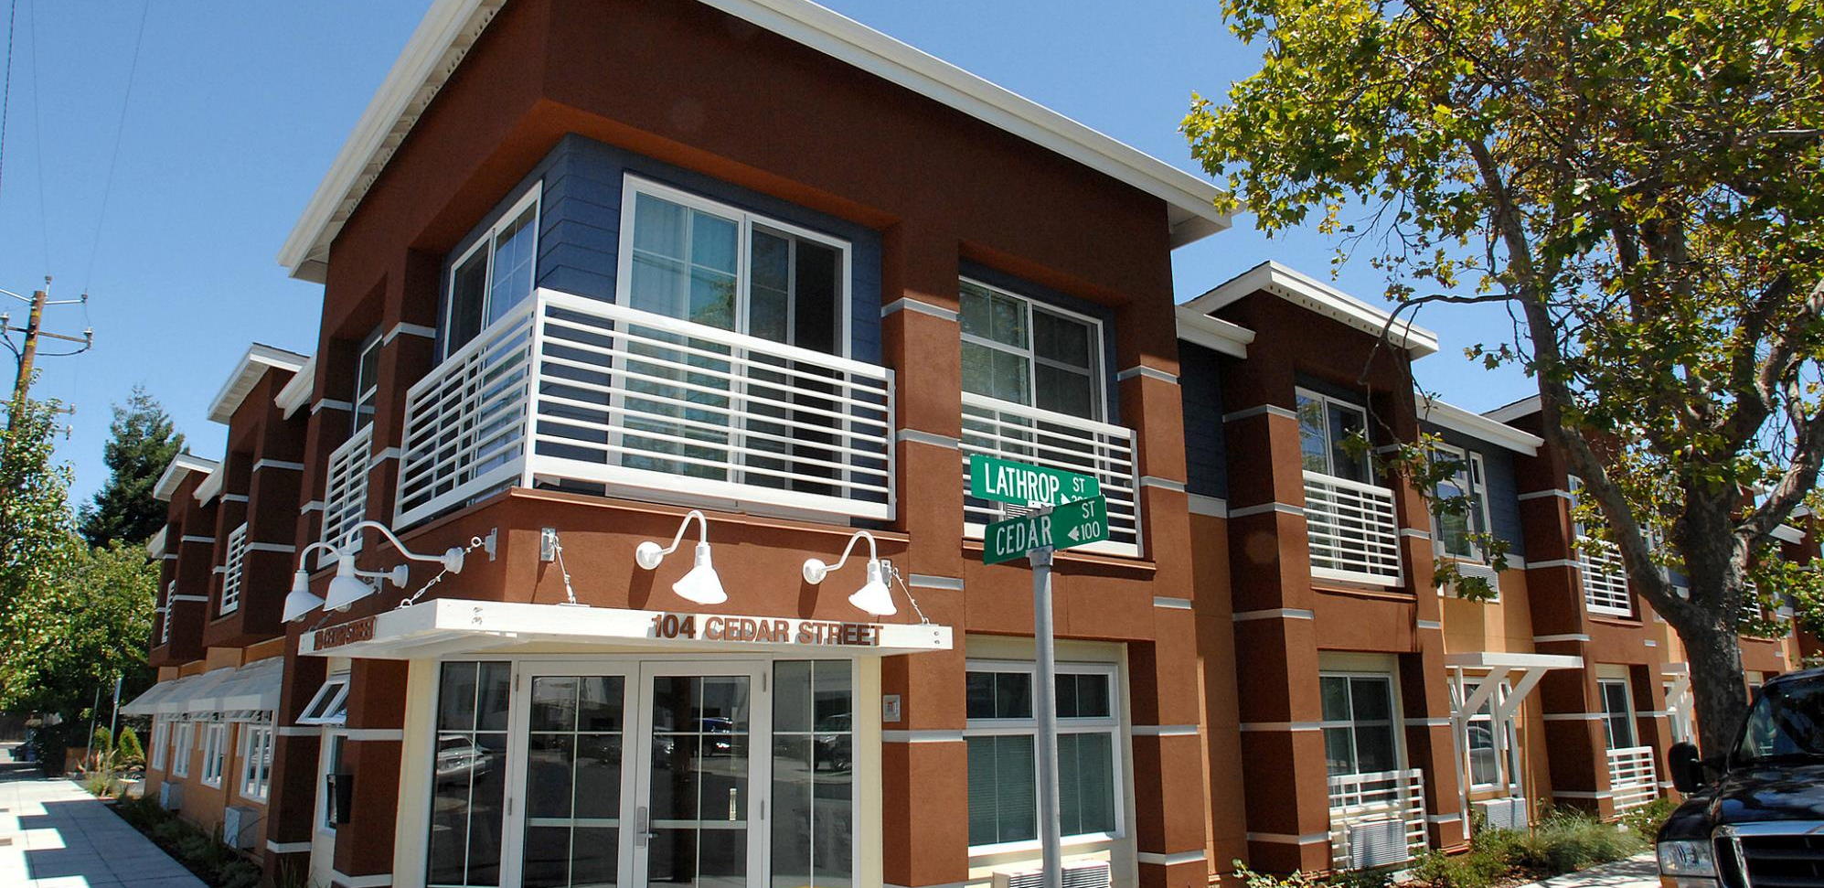
What are Reach Codes?
Local enhancements to state code
Can be adopted at any time
Addresses:
Building electrification – reduced use of methane gas
Electric vehicle (EV) charging infrastructure – increased readiness
Improves economic and energy performance of buildings
Codes are enhanced by stakeholder engagement, why we are here

Slide 4
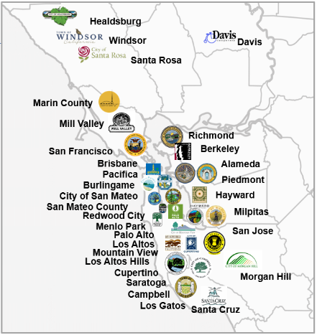
Adoption of Electrification Reach Codes
2019 Initiative Recap
61% of member agencies
57% of electrification Reach Codes statewide
21 of 30 also had EV infrastructure codes
Credit: Redwood Energy

Slide 5
2022-23 Initiative
January Kickoff
February Begin on-going outreach
March-June Cost effective studies
July 2nd draft reach codes, outreach
September-October Local adoption
January 1, 2023 Codes take effect

Slide 6
Presentation Overview
Topics
Building electrification
Electric vehicle (EV) charging infrastructure
New construction
Alterations
Agenda
Technology and feasibility
Costs
Policy models
Tools and Resources

Slide 7
Technology and Feasibility
The all-electric Integrated Genomics Laboratory, Lawrence Berkeley Labs.
Source: Rutherford + Chekene

Slide 8
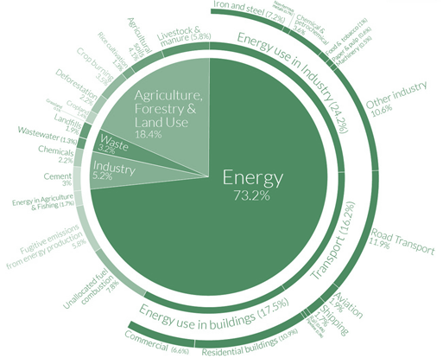
Global Carbon Emissions Sources
18% Commercial & Residential Buildings
12% Road transport
Source: Shayle Kann, Climate Tech VC
In CA, these emissions are overwhelmingly associated with methane gas equipment that can be electrified

Slide 9
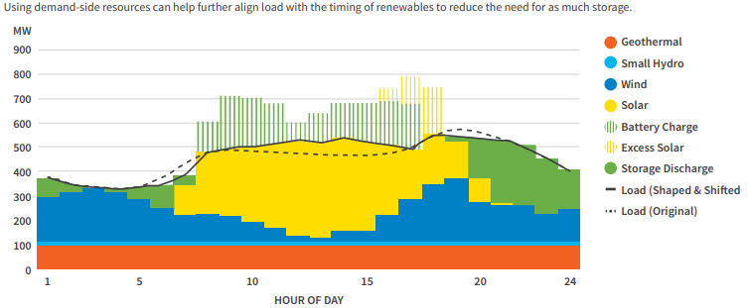
Electrification, Compared to Fossil Fuels
Carbon-free
Lowest-cost, lowest-risk pathway
Healthier indoor air
Job creation
Source: Peninsula Clean Energy 2021
Notes:
CA Executive Order B-55-18 for Carbon Neutrality by 2045
CCAs buy enough carbon free electricity to offset our Bay Area’s usage now
All electric utilities will need to be carbon free 24/7, and that is technically feasible as shown in this chart

Slide 10
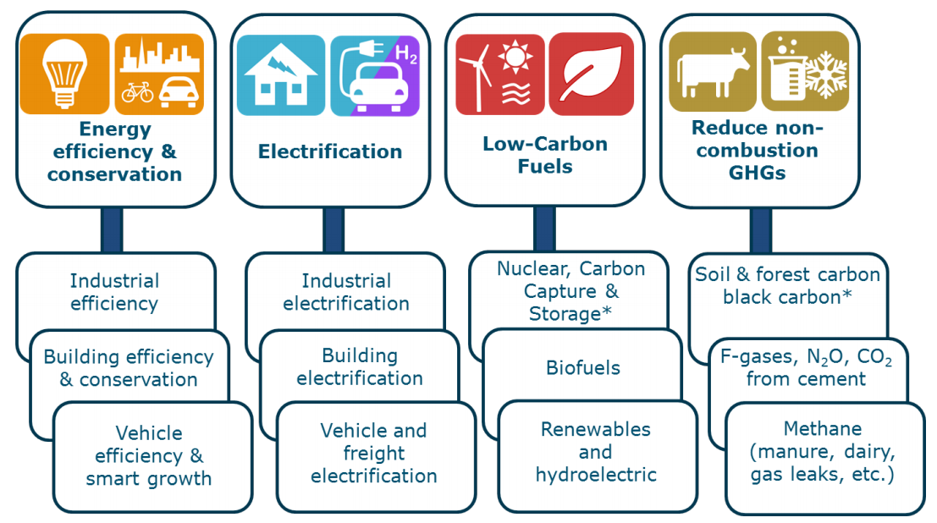
Electrification, Compared to Fossil Fuels
Carbon-free
Lowest-cost, lowest-risk pathway
Healthier indoor air
Job creation
Sources: 1) AB3232 Decarbonization Assessment 2021 2) CA Energy Commission 2018 3) CPUC 2021
Notes:
- Lower-risk pathway according to California Energy Commission.
- Generates substantial cost savings due to avoided new gas infrastructure, and maintenance of existing lines
- Operational costs favoring today’s use of fossil gas will change over time. A November 2021 CPUC Staff Proposal recommends the elimination of gas line extension allowances, refunds, and discounts for new customers, which will impact gas utility rates.

Slide 11
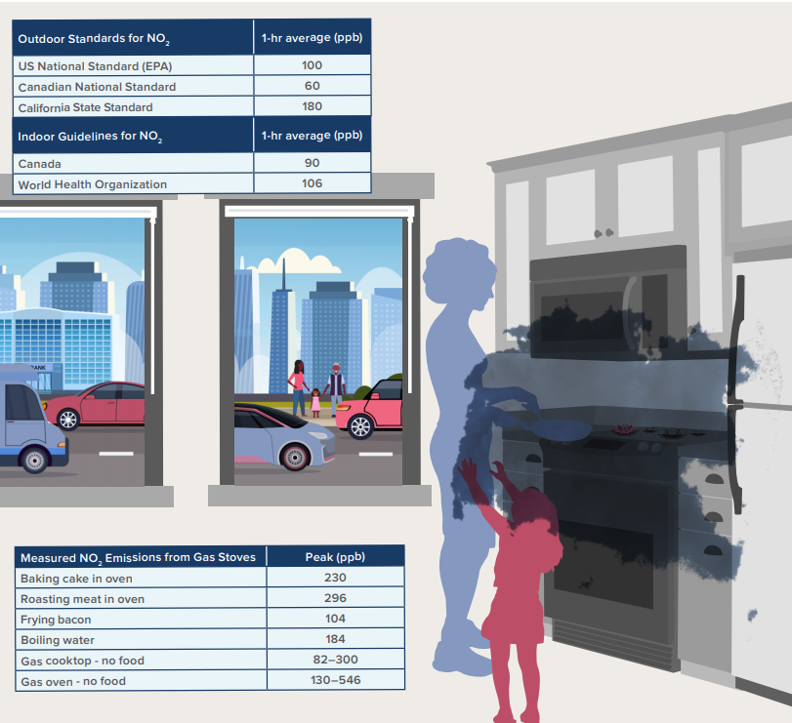
Electrification, Compared to Fossil Fuels
Carbon-free
Lowest-cost, lowest-risk pathway
Healthier indoor air
Job creation
Sources: RMI 2020, CEC 2019
Notes:
Reduced levels of
NO, NO_{X}, NO₂
Formaldehyde
Carbon Monoxide

Slide 12
Electrification, Compared to Fossil Fuels
Carbon-free
Lowest-cost, lowest-risk pathway
Healthier indoor air
Job creation
Sources: UCLA 2019, UMass 2021
Notes:
Studies estimate that job gains far outweigh losses
Furthermore, Newsom’s proposed budget includes nearly $65M for displaced oil and gas workers (well-capping training, early retirement)

Slide 13
California Buildings Gas Usage
Residential
Non-Residential
2009 Residential Appliance Saturation Survey
2006 California Commercial End Use Survey
Notes:
Not focusing on industrial processes (e.g., sterilizing hot water)

Slide 14
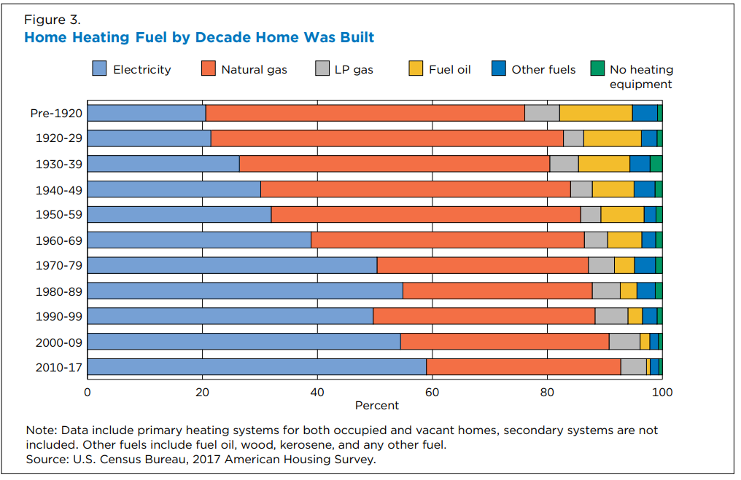
Electric is already the majority
Of national new construction homes:¹
60% use electric space heating (40% of which are heat pumps²)
55% use electric water heating
62% use electric cooking
75% use electric clothes drying
Sources: 1 - 2017 American Community Survey
2 - 2017 IEA Heat Pump Conference Proceedings

Slide 15
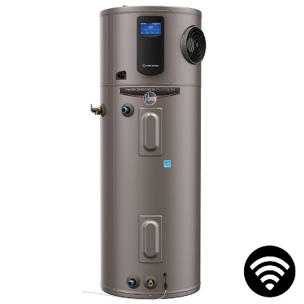
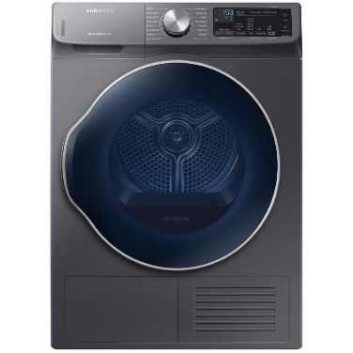
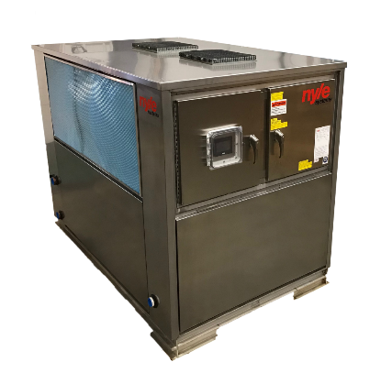
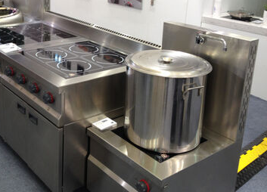
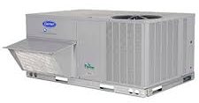
Equipment
Space Heating
Water Heating
Cooking
Clothes Drying
Residential
Commercial

Slide 16
Equipment Efficiency
Space heating,
Water heating,
Clothes drying
Cooking,
High-Intensity Industrial Processes
Notes:
Heat pumps make up a lot of the operational cost difference from having chearper gas than electricity.

Slide 17
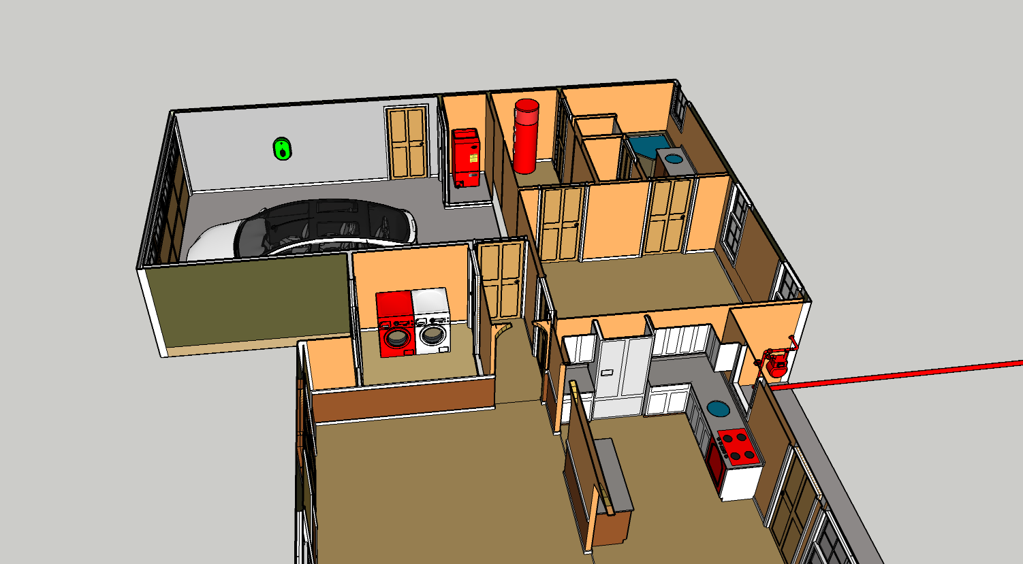
Electrifying New Single Family Homes in the Bay Area – The Cost Story
Water Heater
Capital: $510 ↓
Energy: $7/mo ↑
Summary
All-Electric Home
Capital: $10,580 ↓
Energy: $7/mo ↑
Electric Vehicle Charger
Capital: Same cost, including incentives
On-going: $138/mo ↓
All-Electric Home, Increased Solar
Capital: Equivalent
Energy: $5/mo ↓
Space Heater
Capital: $2000 ↓, assuming air-conditioning also installed
Energy: $10/mo ↓
Gas Meter & Service Not Needed
Capital: $6,000 ↓
Energy: $7/mo ↓
Indoor Gas Piping Not Needed
Capital: $2,450 ↓
Clothes Dryer
Capital: equivalent
Energy: $11/mo ↑
Cooktop
Capital: $380 ↑
Energy: $6/mo ↑
$191 Net Lifecycle Cost Savings per year for an all-electric home versus the mixed-fuel equivalent
3 MT CO2e Carbon Emissions Savings per home, per year based on 2030 grid mix
Capital and energy costs of thermal systems are based on Residential Building Electrification in California by E3 (April 2019); electricity costs assume CCA generation discount
All-Electric Home, Increased Solar bill impacts are based on Low-Rise Residential New Construction 2019 Cost Effectiveness Study by Frontier Energy (August 2019)
Version 8 10/21/2019

Slide 18
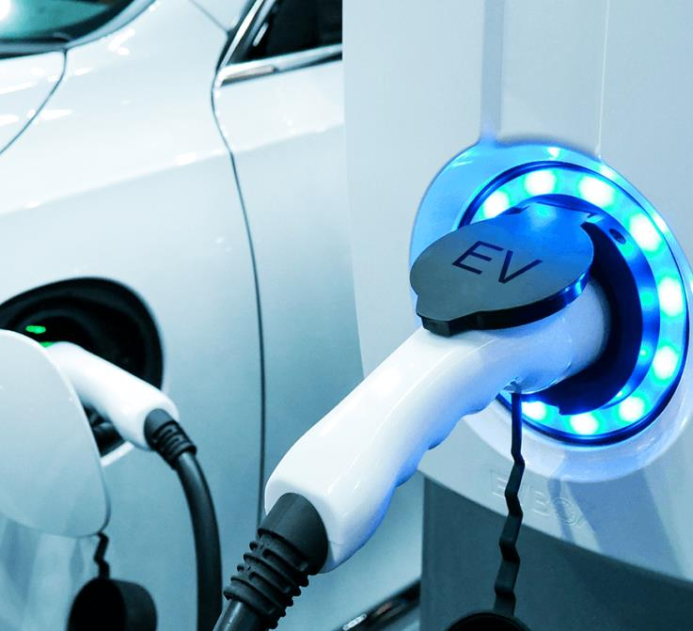
EV Charging Need and Technology

Slide 19
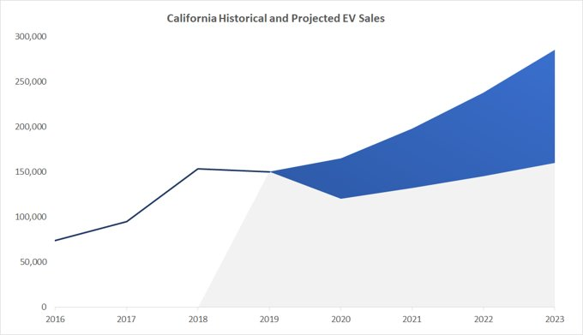
EV Charging Demand
Increase in light-duty EV ownership
250,000 EVs sold in 2021, 12.5% of all vehicles
Sale of gas vehicles phased out by 2035
Pervasive issues
Costs of electrical upgrades
Underserved multi-family housing occupants
Sources: California Energy Commission, EO N-79-20

Slide 20
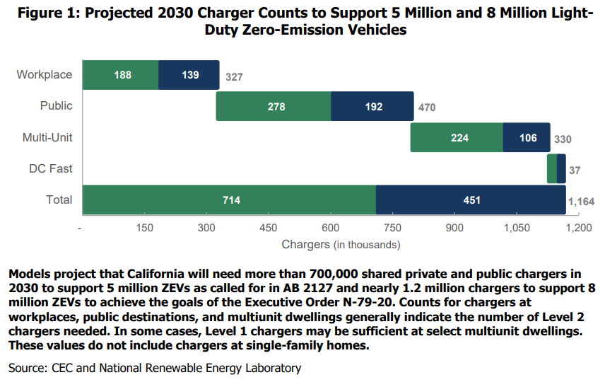
EV Charging Demand
AB2127 Requirements by 2030
CARB Estimates for 2030
Source: CEC and NREL, AB2127 (2021)
Notes:
“A public charging station has parking space(s) designated by a property owner or lessee to be available to and accessible by the public for any period.”​

Slide 21
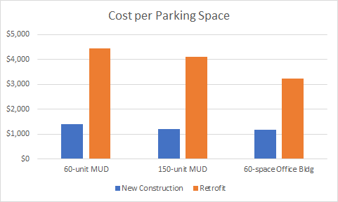
Cost-Benefit - Building
Retrofit costs shown are “best case”
Retrofit can be much higher
PG&E retrofit 'cost-per-port’ ave. is $18,000
Costs include wiring, switch gear, conduit, trenching, and secondary transformer
Sources: 1) Electric Vehicle Infrastructure Cost Analysis for PCE and SVCE 2) Pacific Gas and Electric Company EV Charge Network Quarterly Report, Q2 2020

Slide 22
Automatic Load Management
1 car charging
7.2kW
2 cars charging
3.6kW
3.6kW
4 cars charging
1.8kW
1.8kW
1.8kW
1.8kW
Notes:
This illustration is one approach among several ALMS approaches

Slide 23
2022 Reach Code Policy Models
2022 California Energy Code
Reach codes
Building electrification
Electric Vehicle infrastructure
Discussion

Slide 24
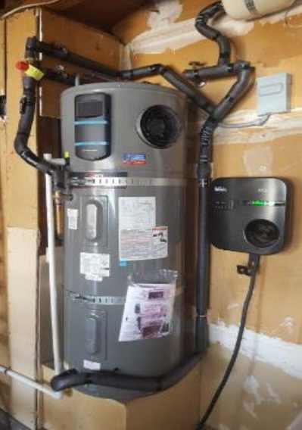
2022 CA Energy Code
New Construction
Existing Buildings
Heat pumps are prescriptive baseline
Residential
Space heating in climate zone 3, 4
Water heating in climate zone 12
Nonresidential – water- and/or space-heating for most building types
Performance credit for all-electric design
Residential
Pre-wiring required for gas appliances
Higher ventilation rate for gas stoves
Energy storage readiness
Nonresidential - Solar PV and Battery Storage prescriptive
Restricts newly installed electric resistance heating
Simplified language for heat pump retrofits

Slide 25
Building Electrification – New Construction
2022 Initiative - Key Concepts
All-Electric Municipal Ordinance
All-electric construction required
Optional exceptions
Infeasible to construct according to CA Energy Code
“Public interest”
Technology-specific exceptions expiring in 2025
Electric-readiness required
New construction definition
If either of the below are replaced over 3 years for purposes other than repair or reinforcement
50% of foundation
50% of above-sill framing, or
Pre-wiring
Physical space
Also restricts extension of any existing gas infrastructure
Find our codes on:
BayAreaReachCodes.Org

Slide 26
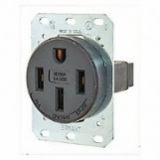
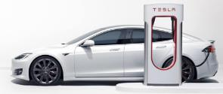
EV Code Terminology
Speed
Readiness
Number
EV Capable
Level 1
3-4 miles per charging hour
Percent of Parking Spaces
EV Ready
Level 2
10-20 miles per charging hour
Level 3
150+ miles per charging hour
EV Charging Station
Notes:
L1 provides nearly 50 miles of range with an overnight charge (3-4 miles for 12 hours) good for most daily vehicle use.

Slide 27
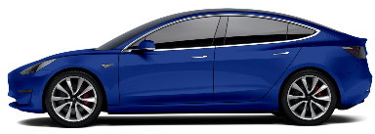
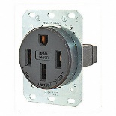
EV Infrastructure – New Construction
2022 Initiative - Key Concepts
 | 2019 CALGreen | 2022 CALGreen | Model Code
 | Mandatory | Mandatory
Single Family Homes and Two-Family Townhomes | (1) Level 2 EV Capable for one parking space per dwelling unit |  | 2 EV spaces total: 1 Level 2 EV Ready circuit 1 Level 1 EV Ready circuit
ELECTRIC
VEHICLE
OUTLET

Slide 28
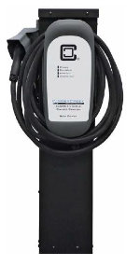
EV Infrastructure – New Construction
2022 Initiative - Key Concepts
 | 2019 CALGreen | 2022 CALGreen | Model code
 | Mandatory | Mandatory
Multi-Family
% of Parking Spaces
% of Dwelling Units with Parking Spaces
10%
5%
25%
15%
40%
60%
85%
10%
5% Level 2 EVCS
25% Level 2 EV Ready (low-power)
10% Level 2 EV Capable
10% Level 2 EV Capable
Low Power Option
40% Level 2 EVCS
60% L1 EV Ready
High Power Option
15% Level 2 EVCS
85% L2 EV Ready (low-power)
AUTOMATIC LOAD MANAGEMENT ENCOURAGED
Notes:
Make clear that load management is explicitly allowed/encouraged in the model code

Slide 29
100% Access is Cost Comparable
Each scenario is 0.3 – 0.5% of construction cost
Assumes $392/ft2 to build per
: Turner and Townsend, 2021
% of dwellings with access
100%
40-60%
100%
100%
Affordable Housing new construction is eligible for PCE incentives
Low Power Option
High Power Option

Slide 30
EV Infrastructure – New Construction
2022 Initiative - Key Concepts
 | 2019 CALGreen | 2022 CALGreen | Model Code
 | Mandatory | Mandatory
Non-Residential
5%
10%
15%
20%
10%
30%
Offices:
20% Level 2 EVCS
30% Level 2 EV Capable
All other:
10% Level 2 EVCS
10% Level 2 EV Capable
6% Level 2 EV Capable
5% Level 2 EVCS
15% Level 2 EV Capable

Slide 31
EV Infrastructure – Existing Buildings
2022 Initiative - Key Concepts
Alterations or additions
Single Family – Parking additions or electrical panel upgrades must meet new construction requirements
Multifamily →
Nonresidential →
Time certain policy (Zoning Code only)
By January 1st, 2025, multifamily and nonresidential properties shall upgrade existing EV Capable spaces required by the locally adopted codes at the time the building was permitted to a minimum of Level 1 EV Ready.
When new parking facilities are added, or electrical systems or lighting of existing parking facilities are added/altered and the work requires a permit:
10% of the total number of parking spaces added or altered shall be EVCS.
All existing EV Capable on-site shall be upgraded to minimum L1 EV Ready

Slide 32
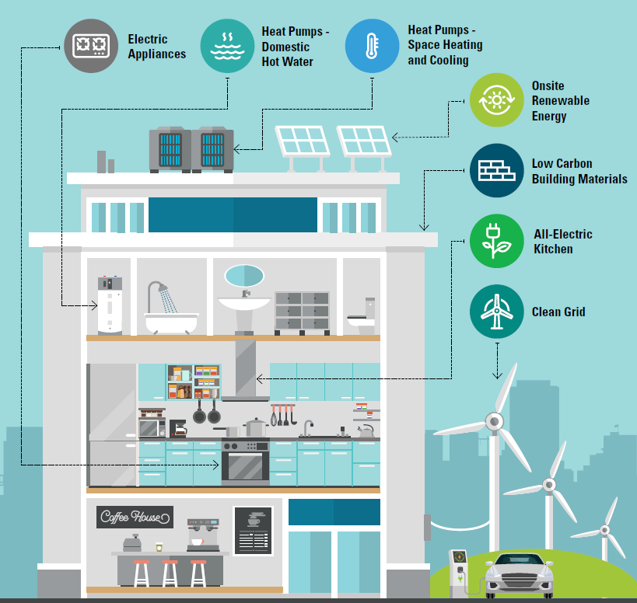
Industry Resources
www.AllElectricDesign.Org Provides free technical assistance on custom projects for practitioners or residents
Building Electrification Technology Roadmap - Covers the technical capabilities of a variety of end-uses
Building Decarbonization Practice Guide Guides architects and engineers towards best practices during design development
Ecosizer Guides engineers and energy consultants for proper design of central heat pump water heating systems
Notes:
Regional public meetings for efficiency and for ‘strength in numbers.’
Permit simplification:
Share state-mandated expedited review requirements and resources
Share city staff trainings for electrification technologies
Develop application resources specifically for electrification projects

Slide 33
EV Charging Incentives
Source: Peninsula Clean Energy Incentives
Property Category | Property Type | Port Type | Port Incentive | Applicable Cap
Existing | Multi-Unit Dwelling | L1 outlet | $2,000 | No cap
 |  | L2 EVSE port | $4,500 | 75% of costs, up to $36k
 | Affordable Housing Multi-Unit Dwelling | L1 outlet | $2,500 | No cap
 |  | L2 EVSE port | $5,500 | Up to $36,000
 | Workplace | L1 outlet | $2,000 | No cap
 | Any | Make Ready circuit | $2,000 | Up to $20,000
New | Market Rate Multi-Unit Dwelling (Above Code) | L1 outlet | $1,000 | No cap
 |  | L2 EVSE port | $2,000 | Up to $40,000
 | Affordable Housing Multi-Unit Dwelling | L1 outlet | $1,500 | No cap
 |  | L2 EVSE port | $2,500 | Up to $100,000
New or Existing | Any | Resilient L2 or DCFC port | $10,000 | Up to $50,000

Slide 34
Thank you! Next Meetings:
Visit us at: BayAreaReachCodes.Org

Slide 35
Common Concerns (1 of 2)
Concern | Response
Distribution grid upgrades are expensive | Sometimes true. Costs are offset by savings of all-electric construction.
Resilience, power-shutoffs | Real problem, but gas does not help. Gas appliance ignition is electric. In emergencies gas is also shut-off. State policy for grid hardening is key.
Uniformity | Fair Concern, but all-electric is simpler & not adopting ensures future risk. PCE and regional partners are encouraging consistency. All-electric is simple and inaction locks in future cost (retrofits, rates) and risk (fire).
In multifamily, central heat pump water heating requires more design expertise and space than gas boilers. | True, training needed. There are scores of working systems, but best practice guidance is available.

Slide 36
Common Concerns (2 of 2)
Concern | Response
All-Electric heating uses too much energy or can’t work in our cool climate | False. All-electric heat pumps are highly efficient and effective in weather far colder than ours. DOE studies show heat pump space heaters as highly efficient at as little as 5 degrees Fahrenheit.
Energy is not clean | False. PCE base service is 100% GHG free today
Equipment is not available | Mostly false. Some scenarios for high-volume or steam applications are more challenging to address. Heat pumps and induction stoves have a long-established history, are widely adopted in other states, but market awareness needs to grow. PCE is addressing training needs.
Notes:
Heat pumps use too much energy or can’t work in our cool climate:
Heat pumps are highly effective in weather far colder than ours. DOE’s National Renewable Energy Lab, in an authoritative 2017 study (link, p.42), cites heat pump space heaters with operating effectiveness at 5 degrees Fahrenheit with a “coefficient of performance” of 3 – which is to say it generates 3x the heat for unit of energy input (heat pumps are essentially refrigerators or AC units in reverse). This is consistent with the California Energy Commissions cost effectiveness studies.

Slide 37
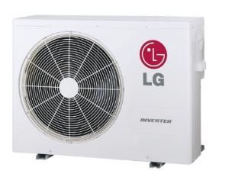
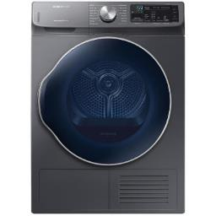
Will Electrification Reduce Resilience?
Heat Pump Space Heating
Heat Pump Water Heating
Induction Cooking
Electric Clothes Drying
Gas furnaces require electric fans, but fireplaces still work.
Gas water heaters require electronic ignition or pumps
Gas stoves will work without electricity, but it’s unsafe
Gas dryers use electric motors to run tumbler
Notes:
Docket – 19-IEPR-01

Slide 38
Can the Grid Handle the Load Increase?
California Energy Commission’s AB3232 analysis indicates that aggressive electrification will result in 20 percent additional summer peak load through 2030. Winter load expected match summer peak load.*
The electricity suppliers have a service obligation to meet your needs. “PG&E fully expects to meet the needs that all-electric buildings will require” -Robert S. Kenney, Vice President, PG&E
CEC has noted electrification as the lower cost, lower risk approach to decarbonization
CA-ISO has performed a 20-year study and has recommended over $30B in transmission investments to account for increased renewables and decommissioned gas power plants
Sources: 1) AB3232 Decarbonization Assessment 2021 2) CA Energy Commission 2018 3) CA-ISO 4) CPUC 2021

Slide 39
2019 Reach Code Initiative - Litigation
Berkeley – Municipal all-electric ordinance: Federal court rejected the plaintiff challenge because the ordinance does not directly regulate either energy use or energy efficiency of covered appliances. Plaintiff has appealed.
Windsor – Energy Code (Part 6) amendment: Agency repealed reach code because the Town could not sufficiently fund legal defense of all-electric reach code.
Santa Rosa – Energy Code (Part 6) amendment: CA court rejected plaintiffs claims regarding CEQA analysis for all-electric reach code. Plaintiff has appealed.
Takeaway: Pending appeals, both a municipal code or building code amendment seem legally defensible.
Source: Climate Case Charts

Slide 40
Building Electrification – Existing Buildings
2022 Initiative - Key Concepts
Our Approach →
Summarize codes and development processes
Financing strategy
Policy considerations
Develop code for “low-hanging fruit”
Statewide Utility Program
BayREN Policy Calculator
Building stock assessment
Stakeholder engagement
Point of permit
Building performance standards
Point of sale
Prioritize
Cost-effectiveness studies
Electric-preferred retrofit ordinance
Air-conditioning installations, new pool permits
“End of flow” date
Reference useful tools

Slide 41
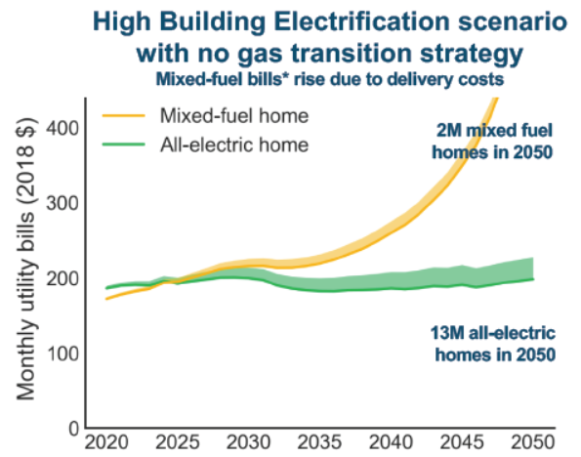
Natural Gas Costs Climbing
CA residential natural gas prices increased 3x faster than electricity prices from 2012 to 2018
Trend expected to accelerate:
Source: EIA https://www.eia.gov/dnav/ng/hist/n3010ca3m.htm https://www.eia.gov/electricity/data/browser/#/topic/7?agg=2,0,1&geo=g&freq=M
CEC Workshop June 6, 2019: Draft Results from E3 study on the Future of Natural Gas Distribution in California
The AB3232 Report represents the most current CEC research supporting that Aggressive Electrification is the primary pathway to meeting GHG reduction targets.
Notes:
CEC studies repeatedly show High Electrification must happen to meet GHG reduction targets. This is the direction that the state is going.
We expect gas prices to rise faster long-term, though the increase will be asymptotic without a gas transition strategy.

Slide 42
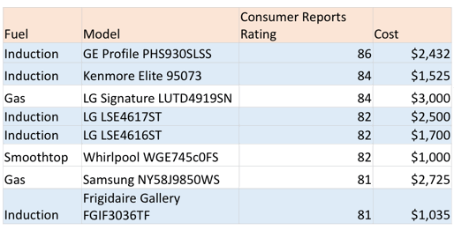
Stoves: Consumer Reports Prefers Induction
6 of top 8 Ranges for 2020 were electric, top 2 were Induction

Slide 43
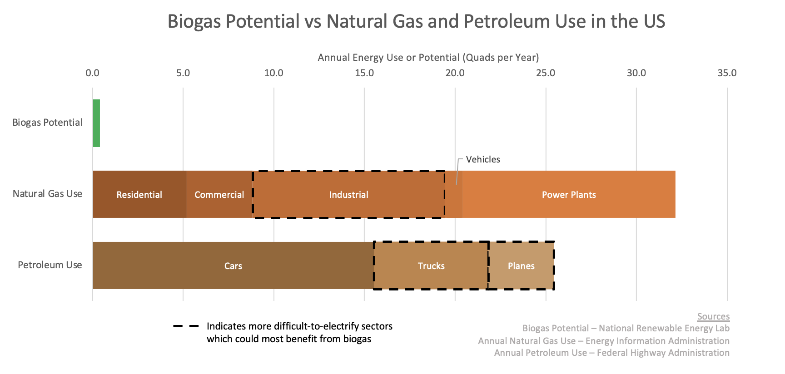
Biogas Can’t Get Us There

Slide 44
Notes:
https://drscleanup.com/2017/10/house-fire-causes-be-safe/
https://www.nfpa.org/News-and-Research/Data-research-and-tools/Building-and-Life-Safety/Home-Structure-Fires

