Slide 1
Existing Building Electrification Suggested Framework and Policy Examples January 2023 Draft

Slide 2
Introduction
There are a variety of complex considerations when designing existing building decarbonization policies, and there is currently no 'one-size-fits-all' approach. East Bay Community Energy, Peninsula Clean Energy, and Silicon Valley Clean Energy intend for these slides to support city staff by:
1) Providing a framework for designing existing building codes (pages 3-4).
2) Leveraging the framework to depict case studies of other city policies (pages 5-10)
3) Highlighting methods regarding equity and related tools (pages 11-15). We will build on these by engaging consultants focused on equity to support community outreach and policy provisions.
Two items that are not explicitly covered in this slide deck:
Industrial building process loads, as these may require unique technological solutions and are most appropriate for state or federal market transformation initiatives.
Incentive programs targeting financial need must be available alongside code requirements. We look to CCA leadership for funding, but also recognize funding roles from municipal budgets, other utilities, air districts, state, and federal sources.
Model codes are available for the following existing building policy options (page 16):
Time of Permit – Electric-required
Time of Permit – Menu Options
Building Performance Standards
Please consider what further support you may need from us to pursue existing building electrification in your City. We are available to support discussions with internal decisionmakers or stakeholders, and help develop a customized strategy.
​
This framework condenses policy options by building type and trigger point to
simplify discussions with local decisionmakers in an organized and deliberate way.
We expect this Framework to evolve and encourage your feedback. Please see our Contact information on the last page.

Slide 3
Definitions
Building Performance Standards are policies that require property owners to regularly report energy- or emissions- use intensity (EUI). In addition, the policies require incremental reductions in EUI over a set time horizon.
Time of Permit policies require that applicants, when they are already pulling a permit for a renovation project, to abide by certain efficiency and/or electrification requirements. These policies avoid missed opportunities to electrify or incorporate electric-readiness at little-to-no additional cost.
Time of Property Transfer policies leverage real estate transactions to disclose relevant information on, incentivize, or require, certain home improvements.

Slide 4
Framework
Increasing owner financing access and electric-readiness
Building Types
Owner- or renter-occupied
Single Family
Multifamily
Commercial / Municipal
Time certain
No Missed Opportunities
Appliance Upgrade Triggers
Building Performance Standards
Periodic benchmarking
Emissions or energy metric
Penalties / fees
Time of Permit
Flexible Compliance
(efficiency and/or electric)
Electric-required
Monitoring Mandating
Time of Property Transfer
Disclosures
Energy Assessments
May also be enforced at Time of Listing*
100% Code Compliance**
Penalties / fees
May also be tied to business licenses or rental license req’s
*Source: Berkeley
**Source: Davis

Slide 5
Policy Examples

Slide 6
San Mateo
Policy Model |  | Single Family | Multifamily, Commercial
Upgrade Triggers | Building Performance Standards
Time of Permit | Time of Permit – Flexible Compliance (efficiency and/or electric)
 | Time of Permit - Electric-required | Electric-readiness, when altered: Panel upgrades, laundry rooms, kitchens, Electric-required: Heat pump air-conditioning, water heaters, pools and outdoor equipment. | Multifamily Electric-readiness: Panel upgrades Multifamily Electric-required: Pools and outdoor equipment
Time of Property Transfer | Disclosures
 | 100% Code Compliance
Population
102,000
Building Stock
Urban and suburban
Energy Burden
~5% of housing units contain occupants that spend >6% of income energy bills, mostly owner-occupied
Source: San Mateo, LEAD

Slide 7
Piedmont
Policy Model |  | Single Family | Multifamily, Commercial
Upgrade Triggers | Building Performance Standards
Time of Permit | Time of Permit – Flexible Compliance (efficiency and/or electric) | Major Alterations Over $30k: 1 measure Over $115k: 2 measures
 | Time of Permit - Electric-required | Electric-readiness, when altered: Laundry rooms, kitchens, and panel upgrades
Time of Property Transfer | Disclosures | Energy Assessment or Energy Audit from last 5 years
 | 100% Code Compliance
Population
11,400
Building Stock
Mostly detached single family, suburban
Energy Burden
~5% of housing units contain occupants that spend >6% of income energy bills, mostly owner-occupied
Source: Piedmont, LEAD

Slide 8
Chula Vista
Policy Model |  | Single Family | Multifamily, Commercial
Upgrade Triggers | Building Performance Standards |  | > 20,000 ft2: EUI reductions and/or audits
Time of Permit | Time of Permit – Flexible Compliance (efficiency and/or electric) | Additions or major alterations: 0-4 measures
 | Time of Permit - Electric-required
Time of Property Transfer | Disclosures |  | BPS Compliance Status
 | 100% Code Compliance
Population
270,000
Building Stock
All low-rise but diverse occupancies, suburban
Energy Burden
~15% of housing units contain occupants that spend >6% of income on energy bills,
mostly renters
Source: Chula Vista 1, CV 2, LEAD
Notes:
What projects trigger this requirement?
Adding square footage
Moving interior walls
Adding windows and doors
These projects do NOT trigger this requirement:
Adding new tile or flooring
Bathroom fixtures
Lighting fixtures
Appliances
Adding or moving a kitchen island
Adding or changing counters
Adding an Accessory Dwelling Unit (ADU/JADU)
Projects that are medically necessary
Repairs without structural changes

Slide 9
Denver
Policy Model |  | Single Family | Multifamily, Commercial
Upgrade Triggers | Building Performance Standards |  | > 25,000 ft2: 30%+ EUI reduction by 2030
Time of Permit | Time of Permit – Flexible Compliance (efficiency and/or electric)
 | Time of Permit - Electric-required | Space heater and water heater (when near cost-parity with like-for-like gas system). Phases across 2023, 2025, 2027
Time of Property Transfer | Disclosures |  | BPS Compliance Status
 | 100% Code Compliance
Population
705,000
Building Stock
Metropolitan
Energy Burden
~15% of housing units contain occupants that spend >6% of income on energy bills, mostly renters
Denver also provides incentives of $3M/year for 2022-24
Source: Denver, LEAD

Slide 10
Portola Valley
Brisbane
Half Moon Bay
Population
4,300
Building Stock
Mostly detached single-family
Energy Burden
~5% of housing units contain occupants that spend >6% of income on energy bills, mostly home-owners
Population
4,700
Building Stock
Detached single-family, low-rise commercial
Energy Burden
~7% of housing units contain occupants that spend >6% of income on energy bills, mostly home-owners
Population
13,000
Building Stock
Mostly detached single-family
Energy Burden
~17% of housing units contain occupants that spend >6% of income on energy bills, mostly renters
Time of Permit – Residential heat pump air-conditioning, electric-readiness for water heater, range, clothes dryer.
Building Performance Standards for buildings >10,000 ft². Cycle begins mid-2023. Currently benchmarking.
End of Flow - By Jan 1, 2045, all fuel gas plumbing decommissioned.
Source: Portola Valley, LEAD
Source: Brisbane, LEAD
Source: Half Moon Bay, LEAD

Slide 11
Seattle, WA
New York City, NY
Vancouver, Canada
Population
725,000
Building Stock
Metropolitan
Energy Burden
~3% of housing units contain occupants that spend >6% of income on energy bills, mostly home-owners
Population
8,500,000
Building Stock
Metropolitan
Energy Burden
~21% of housing units contain occupants that spend >6% of income on energy bills, mostly renters
Population
675,000
Building Stock
Metropolitan
Energy Burden
(?)
PROPOSED
Time of Permit - Commercial alterations must install heat pumps, with some exemptions for electric resistance
Building Performance Standards for buildings > 25,000 ft² - EUI reductions by 2030
Time of Permit – Single family alterations must install all-Electric water heater and space heaters
Source: Seattle, LEAD
Source: Urban Green, LEAD
Source: Vancouver

Slide 12
Palo Alto
Population
67,000
Building Stock
Urban and suburban
Energy Burden
~4% of housing units contain occupants that spend >6% of income on energy bills, mostly home-owners
Time of Permit – Electric-required when water heaters replaced as part of residential addition/alteration, no residential gas line extensions to outdoors
Source: Palo Alto, LEAD

Slide 13
Takeaways
Building Performance Standards are commonly adopted for larger multifamily, commercial buildings
Brisbane, Chula Vista, Denver, New York City, and dozens of other cities have adopted
May be complemented with End-of-Flow (Half Moon Bay)
Time of Permit has been required of all building types
San Mateo, Palo Alto, Piedmont, Portola Valley, Denver, and Seattle
May be a good entry point for single-family
Incentives help (Denver)
Time of Property Transfer is an opportunity to disclose compliance status
Piedmont, Chula Vista, Denver
No examples outside of Davis requiring 100% code compliance
Our framework does not recommend policies which inhibit or delay the sale of a property.

Slide 14
Related Resources

Slide 15
Local ordinances complement CARB and BAAQMD rulemakings
Federal incentives and credits may expire by the time CARB/BAAQMD rules take effect
Reach code adoption does not preclude complimentary policies
Cities can advance market signals for electric appliances for the supply chain
Local adoption will support regional and state rulemaking, establishing local agencies as leaders
Final dates and requirements are in development
Enhancements will always be necessary in coordination with other agencies and governments
Cities may address “end of flow”, “point of sale disclosure” and other needs
Manufacturing volume increases
Workforce development programs and enrollment
Cities can save more emissions
Earlier ordinance adoption reduces gas usage
Additional enforcement mechanisms improve compliance
Cities can protect constituents in advance of CARB/BAAQMD rulemaking
Low/cost measures avoid missed opportunities
Education tool and/or protection against bad investments
CARB/BAAQMD rule specifics are not yet certain
Requiring electric ranges improves indoor air quality and occupant health
CARB/BAAQMD policies are limited in scope to furnaces and water heaters.
Local agencies can adopt supplemental requirements for permits that include other gas appliances, electrical panels, and gas line extensions
California Air Resources Board (CARB) and Bay Area Air Quality Management District (BAAQMD) are proceeding with rulemakings intended to restrict the sale of gas furnaces and water heaters in stores in California and the Bay Area, respectively.
We recommend cities continue adopting Time of Permit reach codes ahead of theses rulemakings based on the following reasons:
Sources: CARB, BAAQMD

Slide 16
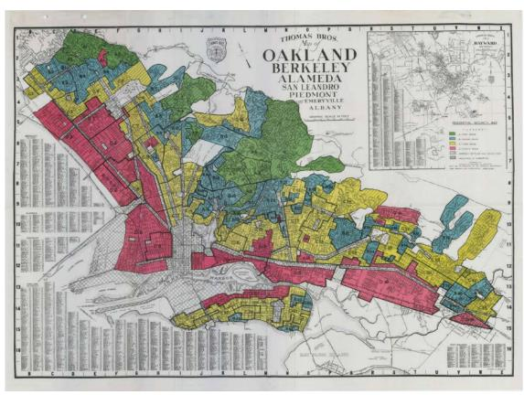
Planning for Equitable Outcomes
Berkeley, San Jose, others have focused strategies
Procedural, distributional, and structural equity
Targeted Universalism
Tenant protections and accessible financing
Ithaca, NY ‘Electrification-as-a-Service’ program
Leverages private equity (via BlocPower) to implement electrification program
Philanthropic capital funds 0% loans to lower-income property owners
Incentive programs, technical assistance
Documented in this literature review
Consider for affordable housing, income level
East Bay redlining.
Source: City of Berkeley
Resources
Existing Buildings Electrification Strategy – City of Berkeley
Equitable Electrification Framework – Greenlining Institute
Equitable Development Scorecard – The Alliance for Advancing Regional Equity
Tenant Impact Recommendations – Natural Resources Defense Council for Los Angeles
Zero Cities Project – Urban Sustainability Director’s Network

Slide 17
Equitable Policy Example Provisions
Chula Vista ordinance does not allow energy improvement costs to be passed on to tenants in bulk
"Amortization of Pass-through Costs. Where lease terms allow owners to pass on the costs of complying with this section to lessees, should Owner choose to do so, those costs may not be passed through in bulk. Instead they shall be amortized as follows:
Audit Requirement costs shall be amortized over five (5) years.
Costs of measure implementation shall be amortized over the expected useful life of the measure."
Institute for Market Transformation model BPS policy establishes a Community Accountability Board and a Building Performance Improvement Board
"Within [X] days of the effective date of this ordinance, the DEPARTMENT shall establish a Community Accountability Board (CAB) composed of representatives of DISINVESTED COMMUNITIES and experts in areas related to racial and social equity to review the impact of the ordinance on DISINVESTED COMMUNITIES and recommend actions to increase equitable outcomes."
Includes template language for explicit responsibilities, budget allocations, and engagement principles
Boards are responsible for ensuring fair and just policy implementation
Source: Chula Vista, IMT,

Slide 18
Exemptions and Fees
Exemptions can be customized to address undesirable policy outcomes, such as:
Exorbitant costs (e.g., electrical service upgrades, or moving the water heater)
Subsidized housing
Technical or physical infeasibility
In-lieu fees can be used to penalize non-compliance, discourage the use of exemptions, and – when an exemption is granted -- raise funds to support decarbonization elsewhere in the jurisdiction. The fee amount may be determined based on a societal cost of carbon, the cost of the future electrification retrofit, or other approach. For example, the City of Santa Monica has enacted a Water Neutrality Program that allows developers to pay $0.18/gallon to offset the costs of new water demanded on site.

Slide 19
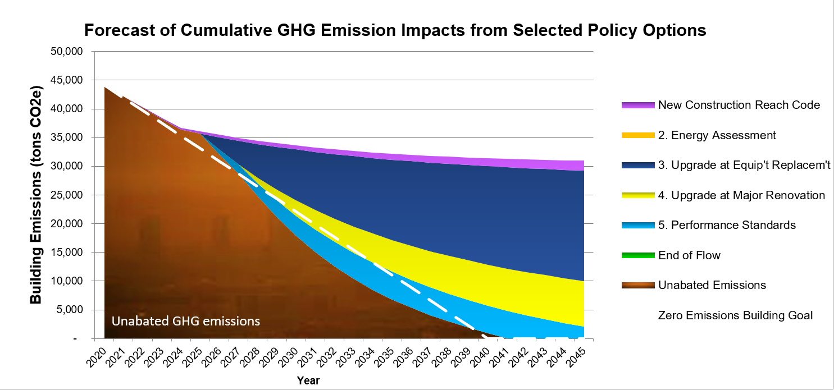
Further Resources
Policy Planning
BayREN Policy Calculator – Play mayor and define pathways toward single-family decarbonization. See how policies complement each other to meet long-term climate goals.
Policy and Financing Literature Review – BayAreaReachCodes.org
Building Performance Standards National Coalition
Source: BayREN Policy Calculator
Model Codes
Time of Permit – Electric-Required – on BayAreaReachCodes.Org
Building Performance Standards – Institute for Market Transformation, used by Denver
Time of Permit – Menu Option – Statewide Reach Codes Program, draws from Chula Vista

Slide 20
Our Approach
Work with staff to support and facilitate stakeholder meetings
Develop list of policy options to meet long-term climate goals
Identify low/no-cost measures
Design targeted programs to protect and empower disadvantaged residents
Next Steps for City Staff
Discuss framework and case studies with stakeholders, including internal decisionmakers
Identify initial strategies that align with city climate and justice goals
Share initial strategies with stakeholders and gather feedback
Reach out to your CCA representative any step of the way​

Slide 21
Contact Us
Blake Herrschaft
Peninsula Clean Energy
BHerrschaft@peninsulacleanenergy.com
Zoe Elizabeth
Silicon Valley Clean Energy
Zoe.Elizabeth@svcleanenergy.com
Allison Lopez
East Bay Community Energy
ALopez@ebce.org
Farhad Farahmand
TRC
FFarahmand@trccompanies.com
Mayra Vega
TRC
MVega@trccompanies.com

